Slide 1


Year 11 GCSEs 2024-JCQ Guidelines
Notes:
Tutors hand out student behaviour and malpractice

Slide 2
Punctuality
It is imperative that you arrive on time to all exams. Late arrivals disturb other candidates.
If you are very late you will still be able to sit your exam, but the exam board may not award any marks for your paper.
The morning exams start at 9.00am. The afternoon exams start at 1.30pm. These are the exam boards normal published start times.
Notes:
If they are running late they should contact us – if they arrive more than an hour after the published start time they are unlikely to be awarded any marks unless we can confirm that they were under centre supervision and had no access to the internet.

Slide 3
Be responsible for your exam equipment
You must only use a clear plastic wallet/bag as a pencil case. Any other type of case or tin will be removed by the invigilator. Do not bring unnecessary equipment.
Ensure you have black biros, a pencil, pencil sharpener, ruler & rubber at the very least. You will need a protractor, compass & calculator for maths, sciences, & where other exam papers allow. Not having the correct equipment delays the start of the exams and we may not have enough to lend – please bring your own.
A water bottle, this must be clear with no writing at all. Labels must be removed. Invigilators will remove any unsuitable bottles. Only water is permitted.
Please leave the cover of your calculator in your bag, along with any other unauthorised items.
Notes:
Our JCQ inspector last year was very hot on this, especially tins of maths equipment – pencil cases, if they use them must be clear and not stuffed full of equipment - rulers/rubbers etc must be “clean” !
We will have emergency equipment to lend as normal.
Water bottles is another hot topic this year – some inspectors have focussed on bottles with big tops where notes could be hidden (?!), and look out for bottles with measurements up the side or other potentially helpful words etc. Water bottles must be filled before they enter the exam room…..they will not be allowed out to fill bottles as they enter the hall.

Slide 4
exam room behaviour
Your mobile phone, notes, revision cards and any other unauthorised items should be in your bag BEFORE you enter the exam room – please do this while waiting on the MUGA
As soon as you enter, you MUST be in absolute silence. Enter on your own, not in pairs or groups and be concerned only with your own equipment and seat.
You MUST NOT talk whilst leaving your bag, finding your seat or leaving the exam room. This is malpractice, and must be reported to the Exam boards.
You MUST NOT communicate with other students in any way, including through eye contact, facial expressions or body language. This is also malpractice.
You MUST face the front throughout the exam, even if you finish early, and when papers are being collected.
Listen carefully to the invigilators’ instructions every time they are given - it is your responsibility to make sure you are following the rules set out by the examination board
Notes:
ICE has been amended this year to stress regulations which protect the integrity of exams : A big one is
“candidates are under formal examination conditions from the moment they enter the room in which they will be taking their examination(s) until the point at which they are permitted to leave. Any malpractice suspected or actual, from this point must be reported to the relevant awarding body. Candidates must not talk to, attempt to communicate with, or disturb other candidates once they have entered the examination room.”
Students must not enter the exam room whilst still reading revision notes or cards – everything they don’t need and any unauthorised items must be already in their bags, and their equipment should already be out – we need to try and avoid students at the back of the hall sorting through their bags and turning their phones off – this all needs to happen outside. It makes the process quicker too, and helps eliminate the whispering and hi fiving……

Slide 5
Malpractice
Invigilators have a duty to report any suspected or actual cases of malpractice to the Exam Boards. If you try to cheat or break the rules in any way, you could be disqualified from all of your subjects.
These include:
Any form of communication with another student, e.g. talking, whispering, making eye contact, trying to distract another student, laughing, sitting sideways, turning, talking or whispering as you leave the room
Disruptive behaviour, shuffling, noises, repetitively coughing or sniffing, excessive stretching etc.
Having on you, or using unauthorised items, such as phones, smart watches, watches, ear buds and notes, writing on hands, legs (either before or during the exam) and in shoes
Beginning to write before the Invigilator tells you – this includes completing your name and candidate number.
Leaving the exam room unaccompanied once you have entered (even if the exam has not started)
Notes:
The invigilators are also there to help solve any problems so that you can do your best – if anything doesn’t seem right please please please tell an invigilator so we can do something about it – if appropriate. It is too late once the exam has finished – for example, not being able to hear a listening exam, not being able to see a video, not having the right tier paper, not having the right access arrangement eg laptop/reading pen etc

Slide 6
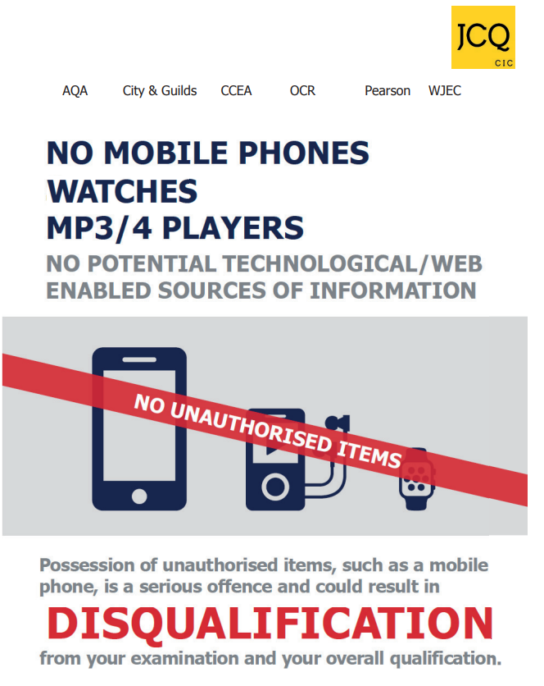
UNAUTHORISED MATERIALS
Of all the reported cases of malpractice in the 2023 exam season, 44.5% were for having mobile phones and smart devices in the exam room.
Of those cases, 83% resulted in the candidate losing all marks for the
component, (65.6%) or not being able to claim their certification (17.4% )
It makes no difference whether it is an innocent mistake or if a candidate intends to cheat, or is caught cheating – as an exam centre we HAVE to report it and the exam board WILL take action.
This has happened here, and students have lost all marks for the paper they were sitting even though they made an innocent mistake. We remind you at the beginning of every exam – so before you enter the exam room:
MAKE SURE YOUR PHONE IS SWITCHED OFF AND IN YOUR BAG !!
Notes:
Mobile phones - 2180 cases in 2023, up from 1825 in 2022
This is the most worrying one!! Even at the end of the last set of mocks students were still taking their seats with phones in their pockets – particularly in the afternoon. We read the same announcement every exam so it is really difficult to complete the malpractice forms in any way that supports a student who forgets they have their phone on them, and in the two cases I’ve dealt with here – one of which was appealed at parent’s request, we’ve had no success at all. If they follow the instructions about making sure their phones are already in their bags before they enter it should help…….

