Slide 1
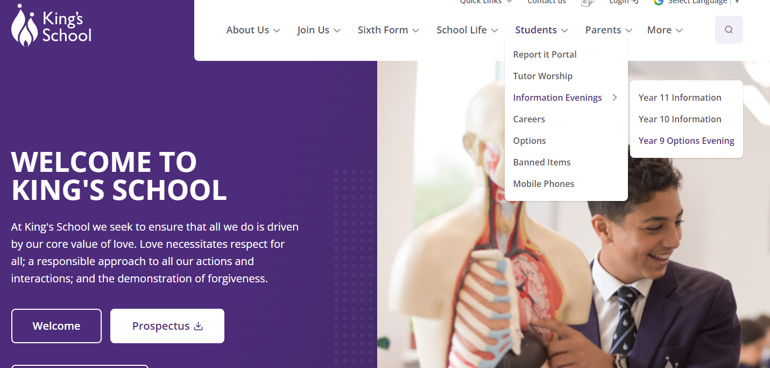
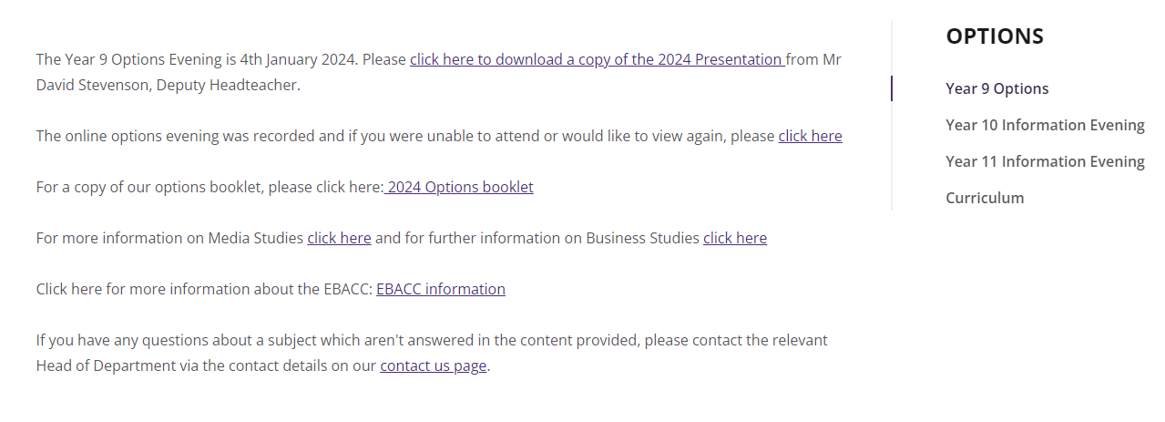

Slide 2

The Options process

Slide 3
The journey
Step 5 → | Career ↑
Step 4 → | University ↑ | College ↑ | Training ↑
Step 3 | KS5 They choose their degree/Higher/Further Education Courses
 | A-level courses ↑ | Other Level 3 courses ↑ | Apprenticeships & traineeships ↑
Step 2 | They choose a from a wide range of courses or training routes
 | KS4 GCSE/Level 2 courses ↑ They work hard to get good GCSE grades
Step 1 | They must choose their GCSE options
 | Key Stage 3 ↑ Years 7 – 9
Notes:
We are at the end of step 1

Slide 4
Timeline
9th Jan.
Options Information evening
29th Jan.
Parents’ Evening
14th Feb.
Completion of Options choices deadline
SLT interviews

Slide 5
How we have decided the subjects
Government guidance e.g. EBACC
Experience from RET (our family of schools)
The school’s ethos and character - RP
University entrance and ambitious careers
A broad curriculum
Opportunities to study the arts and practical subjects

Slide 6

Will all students get their first choice?
We will try our utmost
We have not created blocks ahead of options choices
It may not be possible
That is why we ask for a reserve option – please take this choice seriously!

Slide 7
How to decide
Good reasons to choose a course
Bad reasons to choose a course
I am good at this subject
I enjoy this subject
I am interested in this subject
This subject enables me to do well in the future
My friend is choosing it
I like the teacher
I don’t like the teacher
It sounds easier

Slide 8
Core Curriculum and Options
Geography
History
Media
Music
Physical Education
Spanish
The core curriculum studied by all students will be:
English and English Literature
Mathematics
Science (double or triple)
Religion and Philosophy
PSHE – Non-Examined
Core PE – Non-examined
Daily Worship – Non-Examined
= 6/7 GCSEs
Students will then choose 3 subjects from the list below.
Art and Design
Business Studies
Computer Science
Design & Technology
Drama
French
Food and Nutrition
Geography
History
Media
Music
Physical Education
Spanish
This means most students will complete 9/10 GCSEs

Slide 9
Pathways and blocks
All students study | Set option subjects (choose 1) | Free Options to choose
Main core curriculum plus (6/7 subjects) | French, Geography, History or Spanish | Plus 2 more subjects

Slide 10

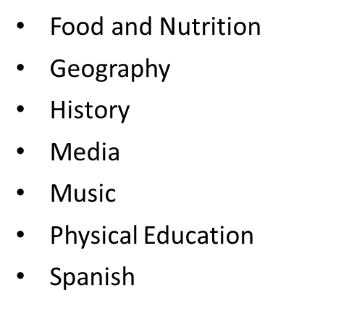
The choices will look like this
Preference 1 | French, Geography, History or Spanish
Preference 2
Preference 3
Reserve choice

Slide 11
Possible new choice – GCSE Dance
We are considering adding this as a subject
This will depend on several factors – uptake, impact on other subjects etc.
On the options choice form if you choose dance you must also choose an alternate
This will mean I can model with Dance included and without

Slide 12
If you want to choose Dance …
Preference 1 | French
Preference 2 | Dance or Drama
Preference 3
Reserve choice
Choose Dance AND another subject as an alternate
e.g.
Dance and Drama
Dance and History
If not, I will use the reserve choice to model the options blocks

Slide 13
What if I think my child will not be able to access these courses due to a learning need?
EHCP – will have been discussed in annual reviews. SEND team will contact and discuss.
K coded (no EHCP) – we believe our choices and our teaching make all option choices accessible.
We have high expectations and ambitions for all our students, and we make our subjects inclusive for all.
We believe that the choices we offer provide appropriate options for all students. If you have concerns or questions relating to this, contact the SENDCO inbox ( sendco@kingsschoolhove.org.uk )

Slide 14

The EBACC – a broad curriculum

Slide 15

What is the EBACC?

Slide 16
Why is the EBACC a good option for most students?
A study by the UCL Institute of Education shows that studying subjects included in the EBacc provides students with greater opportunities in further education and increases the likelihood that a pupil will stay on in full-time education.
Sutton Trust research reveals that studying the EBacc can help improve a young person’s performance in English and maths.
https://www.gov.uk/government/publications/english-baccalaureate-ebacc/english-baccalaureate-ebacc

Slide 17
Why is the EBACC a good option for most students?
Some statistics the government give to encourage students to choose EBacc subjects:
In 2012 92% of those who entered an undergraduate course at Oxbridge had studied a language … and 88% had studied a humanities subject.
For Russell Group Universities 82% of those who entered an undergraduate course at a Russell Group University had studied a language and 82% had studied a humanities subject.

Slide 18

Why languages?
Languages are rewarding subjects that broaden horizons and give travel and employment opportunities.
It is normal for a student to feel they are not as good at languages compared to other subjects – they have usually been studying them for less time.
Employers and Universities really value languages and studying a language can help open doors.

Slide 19
Why languages?

Slide 20
Implications for choices
We require the study of a humanities subject or a language.
We recommend the study of both!
This still leaves one other free choice
It is possible to choose 2 languages, or History and Geography, or any combination of 3 of these subjects
We recognise the full EBACC is not best for all students. We will discuss this when we interview students.
It is not necessary for students to take subjects at GCSE to go on to study them later or have careers in related fields.

Slide 21
The choices will look like this
Preference 1 | French, Geography, History or Spanish
Preference 2
Preference 3
Reserve choice

Slide 22
What next?
Discuss with your child
Read the options booklet carefully
Make appointments for year 9 parents’ evening based upon your possible subject choices
Complete the options form together when they receive it and hand in to the office by half term

Slide 23


Slide 24

What is Unifrog?
Unifrog is a one-stop-shop where students can easily explore their interests, then find and successfully apply for their next best step after school.
Unifrog will help you to explore your key interests and what career paths you can take to reach your goals!

Slide 25


Exploring pathways
Use the tools in the Exploring pathways section to research the career pathways and subject fields that lie beyond school or college and understand how to access them.

Slide 26
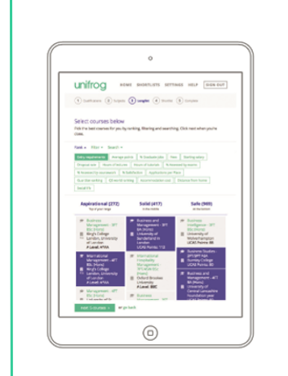
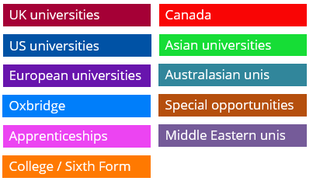
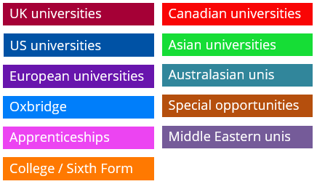
Searching for opportunities
Use the tools in the Searching for opportunities section to compare universities, degree options, apprenticeships and college courses.

